Slide 1




Lesson 1 · Writing
Understanding
line graphs
.
What line graphs are, how to read them, and what IELTS Writing Task 1 asks you to do with them.
Notes:
Welcome. This lesson introduces line graphs and what IELTS Writing Task 1 asks you to do with them.

Slide 2
LEARNING OBJECTIVES
By the end of this lesson, you will be able to:
01
Identify the key parts of a line graph.
02
Recognise the difference between single and multiple line graphs.
03
Explain what IELTS Writing Task 1 asks you to do.
04
Identify the key features to include in your answer.
Lesson 1 · IELTS Writing Task 1 · orangeenglish.nl
2
Notes:
Here is what students will be able to do by the end of the lesson.

Slide 3
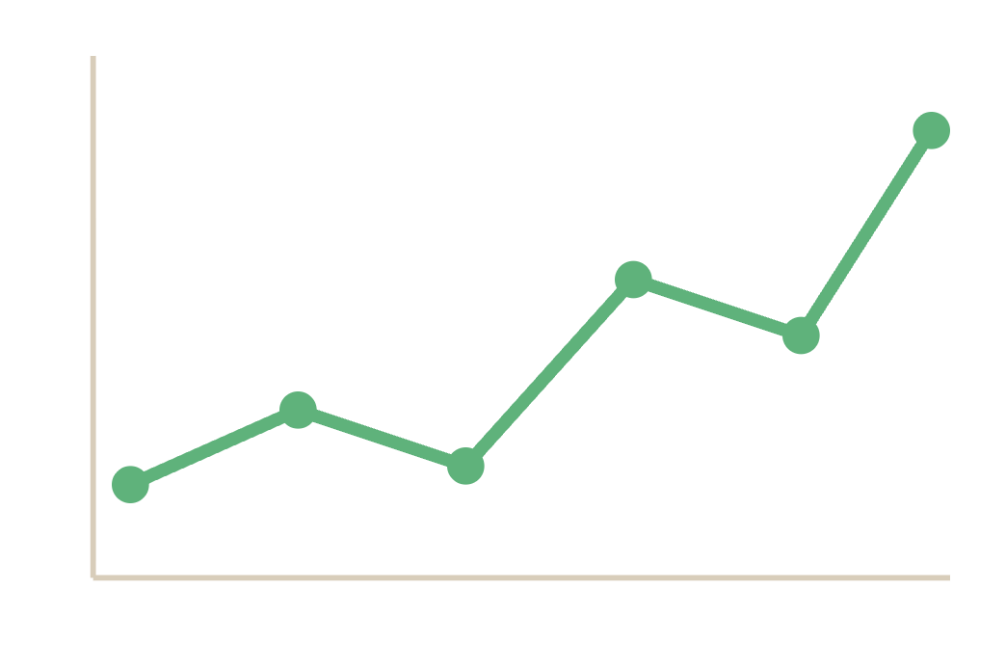

WHAT IS A LINE GRAPH?
A line graph shows how something
, plotted as a continuous line.
changes over time
It's the most common chart type in IELTS Writing Task 1.
Lesson 1 · IELTS Writing Task 1 · orangeenglish.nl
3
Notes:
Define a line graph and note that it is the most common Task 1 chart type.

Slide 4
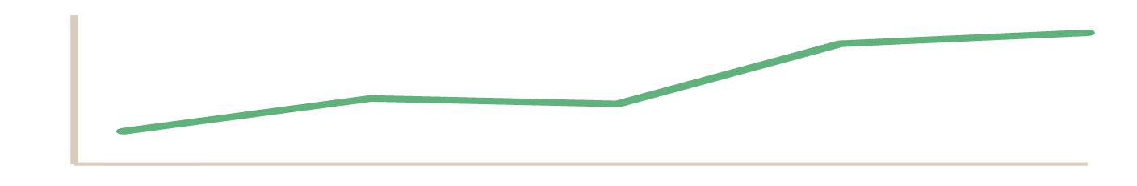

TYPES OF LINE GRAPHS
Single or multiple, read them differently.
Single line
Multiple lines
Tracks one category over time, no comparison needed. Focus on the shape and stages of the trend.
Several trends to compare. Focus on similarities, differences, and the crossover points between lines.
"rose steadily, then plateaued, before climbing sharply"
"tea sales overtook coffee sales in 2015"
Lesson 1 · IELTS Writing Task 1 · orangeenglish.nl
4
Notes:
Single line versus multiple line graphs, and the staging language for describing a trend.

Slide 5
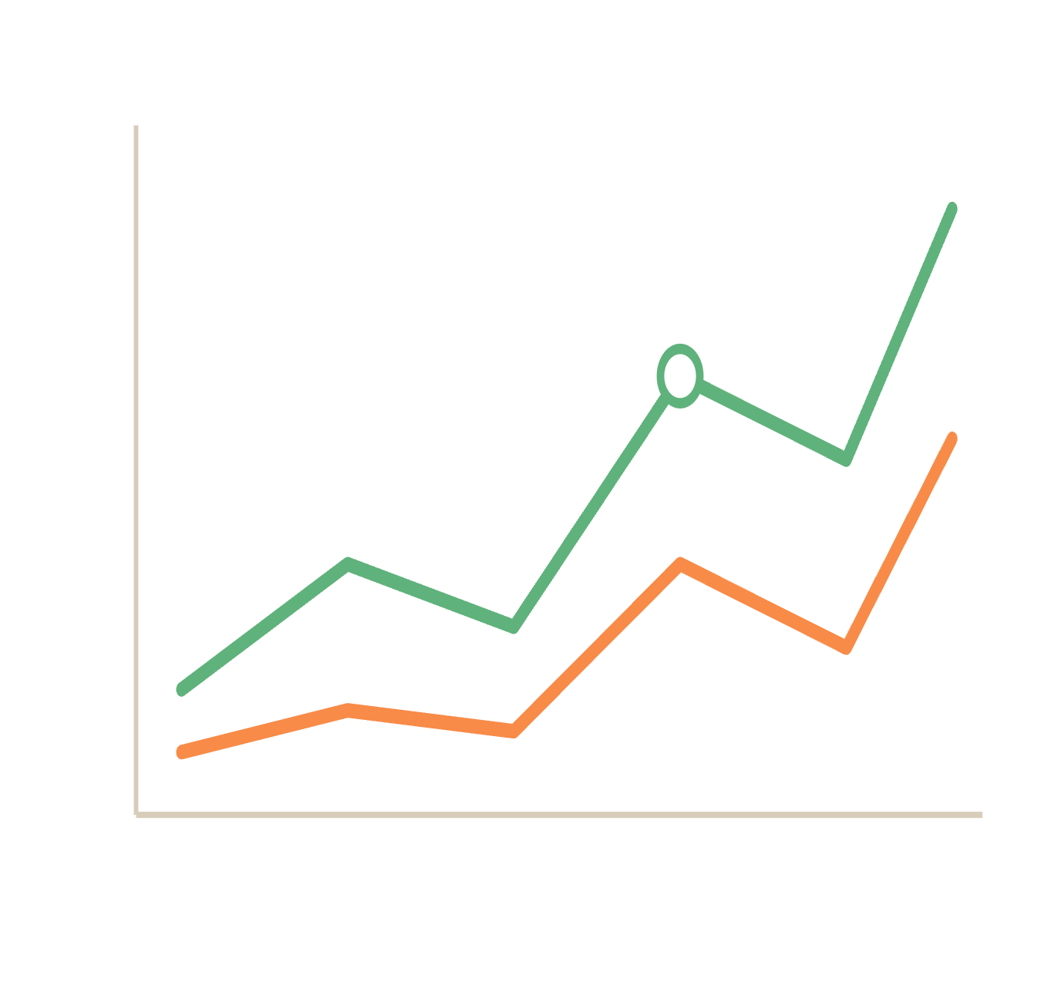
PARTS OF A LINE GRAPH
Know every part before you write.
1
examiner mode
Internet users by age, 2010–2020
1
Title, what's being measured.
2
X-axis, the time period.
5
3
Y-axis, the quantity measured, plus units (%, kg, millions).
4
Legend, which line is which.
3
5
Data point, the exact value at a given time.
reminder
Always include units when describing values.
4
2
Lesson 1 · IELTS Writing Task 1 · orangeenglish.nl
5
Notes:
Examiner Mode. Walk through the five labelled parts and remind students to always include units.

Slide 6



WHAT TASK 1 ASKS YOU TO DO
The instruction always asks three things:
follow the 3 steps →
01
02
03
Select
Describe
Compare
Choose the
features. Don't describe everything.
most important
Report the data
, with the right units.
accurately
Show how the lines
to each other.
relate
common mistake, repeating numbers
WEAK
STRONGER
The number went up a lot.
The number increased sharply.
Lots of people used it.
A large proportion used it.
Lesson 1 · IELTS Writing Task 1 · orangeenglish.nl
6
Notes:
The three things every Task 1 instruction asks: select, describe, compare. Then the common mistake of repeating numbers.

Slide 7
KEY FEATURES TO NOTICE
Before you write, look for these five things.
01
Overall trend
02
Start and end points
Is it going up, down, or staying stable?
Where each line begins and finishes.
03
Significant changes
04
Peaks and troughs
Sharp rises or sudden falls.
The highest and lowest points.
05
Comparisons
Which line is highest, or whether lines cross.
Lesson 1 · IELTS Writing Task 1 · orangeenglish.nl
7
Notes:
The five things to look for in any line graph before writing.

Slide 8
ACTIVITY
your turn!
Match each term to its definition.
Drag each term on the left to the meaning it belongs with on the right.
Title
What's being measured, the heading of the graph.
X-axis
The time period running along the bottom.
Y-axis
The quantity measured, running up the side.
Legend
The key showing which line is which.
Data points
The exact values plotted on each line.
How values are counted, %, kg, millions.
Units
Lesson 1 · IELTS Writing Task 1 · orangeenglish.nl
8
Notes:
Activity. Students drag each term to match its definition.

Slide 9
KEY TAKEAWAYS
What to carry into your writing.
A line graph shows change over time, check the title, axes, and units first.
Graphs can be single or multiple, read each kind differently.
Task 1 asks you to select, describe, and compare, not describe everything.
Look for the overall trend, start/end points, peaks, troughs, and comparisons.
next up →
Vocabulary for Trends
Lesson 1 of 6 · IELTS Writing Task 1 · orangeenglish.nl
9
Notes:
Recap the four takeaways. Preview the next lesson: Vocabulary for Trends.

